Slide 1
Feature Extraction from Comments
Reuel Samuel Sam - 2018103053
V.S.Suryaa - 2018103610
S.Srihari - 2018103601

Slide 2
Abstract
In this day and age, where the internet has taken control of most people’s lives, social media exists as one of the most powerful platforms to share and voice one’s opinions. People put up content looking for appreciation and constructive criticism from the general public to help improve their skills in their art. The high volume of user-generated content makes a manual analysis of this discourse unviable. Consequently, automatic analysis techniques are needed to extract the opinions expressed in users’ comments, given that these opinions are an implicit parameter of unquestionable interest for a vast section of the society. Our project aims to automate this task of analysing the reactions on the posts and generate a report based on the outcome. Viewers of the post are provided a feature to predict the number of likes their comment would yield based on the post and existing comments.
Keywords or phrases: Compiler Design, Python, Comment analysis, Neural Network, Database, Lexical Analysis
Notes:
In this day and age, where the internet has taken control of most people’s lives, social media exists as one of the most powerful platforms to share and voice one’s opinions. People put up content looking for appreciation and constructive criticism from the general public to help improve their skills in their art. In these scenarios, users can speak freely on any relevant topic. The high volume of user-generated content makes a manual analysis of this discourse unviable. Consequently, automatic analysis techniques are needed to extract the opinions expressed in users’ comments, given that these opinions are an implicit parameter of unquestionable interest for a vast section of the society. These posts and the corresponding comments left on one's handle, assist people in decision making under various situations based on the opinions of other people. Many a times these comments influence one's thought process while making decisions due to higher number of likes and comments viewed on such posts. However, these responses usually in the form of comments, are at times more negative and positive and thereby may cause some form of emotional pain to the original content poster. Our project aims to automate this task of analysing the reactions on the posts and generate a report based on the outcome. This project tries to tackle this situation head on by segregating the comments left on posts into three main categories - positive, neutral and negative. The comments are analysed using a Lexicon based sentiment analysis approach that breaks down the comment to its constituent parts and provides the user an output with desirable filtered comments. Socially concise individuals use this platform to impact lives. Many comments on a post tend to be interpreted is a number of ways that contrast with what was intended. In order to overcome this ambiguity in expression, the viewers of the post are provided a feature to predict the number of likes their comment would yield based on the post and existing comments. Decision to express or not is in their own hands.

Slide 3
Literature Survey
S.No | Author-Publication- Year | Methodology | Advantages | Limitations
1. | Rajdeep Singh, Roshan Bagla, Harkiran Kaur - 2015 | Lexicon based sentiment analysis to analyse the emotion in the comments and provide statistics of likes and dislikes. | Proposes a methodology to identify the polarity of popularity without much hassle and effort. The work also takes into consideration the overall impact of different parts of speeches in grammar. | Takes a very rudimentary approach to analyse the sentiment by taking same polarity for a number of words and thus not indulging the intricacies. Assumes that the user interacts with proper grammar and avoids spelling check.
2. | A.Moreo, M.Romero, J.L.Castro, J.M.Zurita - 2012 | Mainly composed of two modules – Focus Detection and Sentiment Analysis. It analyzes each sentence in the comments to create a set of tuples that abstractly represents users’ opinions by assigning sentiment expressions to opinion focuses. | Contains colloquial expressions that are of crucial importance to analysis. Hierarchical structure to improve results of focus detection. | Requirement of sufficient information is a must. Also unable to detect hints of sarcasm and satire in comments.

Slide 4
Literature Survey
S.No | Author-Publication- Year | Methodology | Advantages | Limitations
3. | Dilesh Tanna, Manasi Dudhane, Amrut Sardar - 2020 | Adopted LICW – text analysing software along with SVM, maximum entropy and Naïve Bayes models | Notifies close circle and doctors about the extreme emotions of the user based on his reactions to posts thereby ensuring that improper decisions aren’t taken. | The users are individually rated based on their response to other posts. The impact of an individual post and its response hasn’t been taken care of.
4. | Anees Ul Hassan, Jamil Hussain, Musarrat Hussain, Muhammad Sadiq, Sungyoung Lee - 2017 | Analyzed the different cultural variations, take out emotions, and obtained the sentiment behind ML techniques, comparing them on sentence-level for depression measurement. | Proposed a multi-class emotion classifier that determines emotions with greater precision. | Meta Learning tends to be in-accurate and is problematic with timing and maintenance with complex models
5. | Persia.F, D’Auria.D - 2017 | Surveying opportunities and challenges in Online Social Networking with emphasis on the most popular users. | Receiving personalized posts based on liked ones. Focus on semantic security and coping up phishing attacks with celebrities | Combining the views of the close circle general public, makes the media uninviting. Ways to filter responses from comments not discussed.

Slide 5
Problem Statement
Tackling a domain as wide as social media and its influence comes with a lot of preparation. The Literature Survey gives a description of the issues faced by the previous approaches to this problem. To overcome the issues of need of proper grammar, analysis of comments one by one, detection of sarcasm etc. we have resorted to ‘Afinn’ that attempts to tackle these issues. Furthermore, to add our own originality to this issue, we have included more features such as like prediction, displaying highest tag count, count occurrence etc.

Slide 6
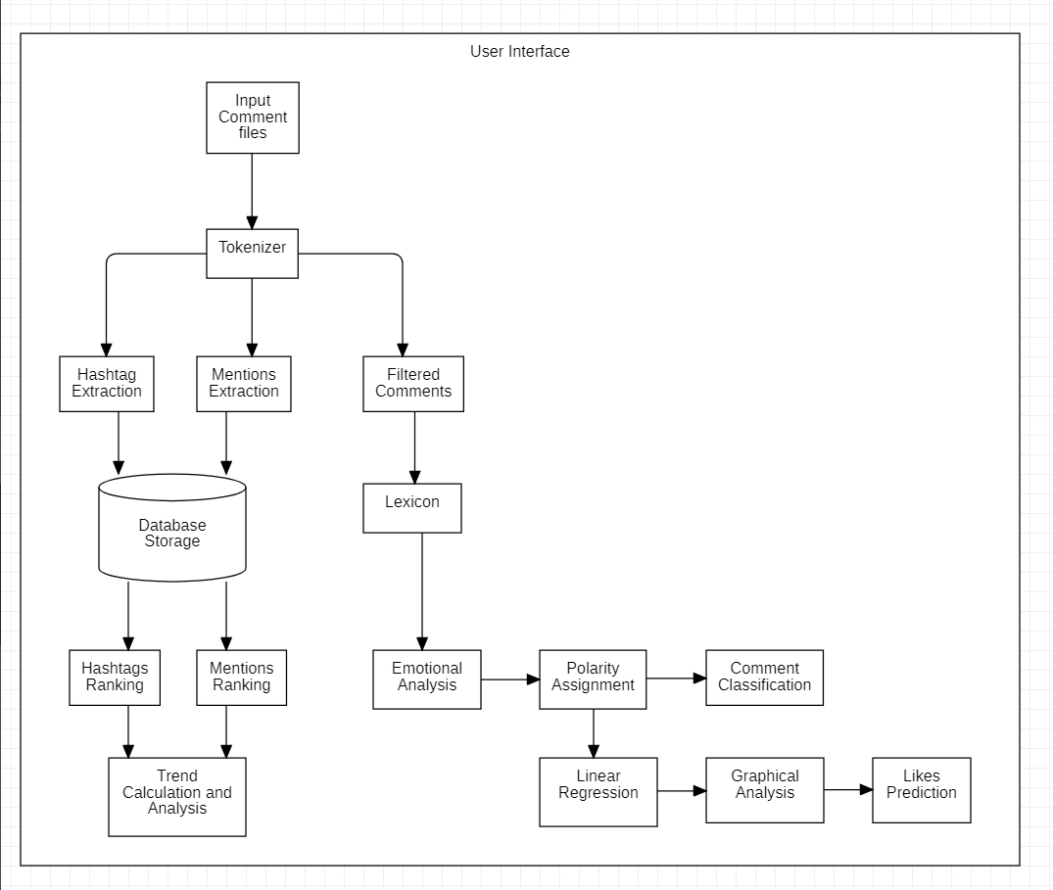
Basic Flow Diagram
Srihari.S
Reuel Sam
V.S.Suryaa

Slide 7
Module 1: Tokenizer
Input:
The comments in a post “x” are stored in a file x.txt. The likes obtained by the comment are also entered by the user in the same file.
Intermediate Results:
Module-1 is composed of three phases:
Extraction of Mentions
Extraction of Hashtags
Extraction of Filtered Comments

Slide 8
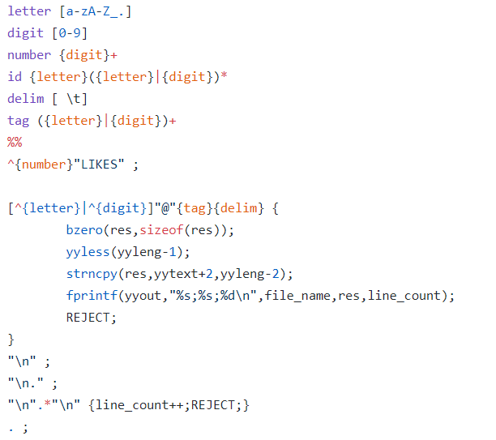
Module 1 Phase 1: Extraction of Mentions
An account is considered mentioned if it is of the form @account_name
Output:
A file x_mentions.txt is created which contains the list of accounts that have been mentioned in a comment of post “x”.
The details in x_mentions.txt are stored in the format:
PostID;account_name;CommentNumber
Definition of a mention
Keeps track of comment number

Slide 9
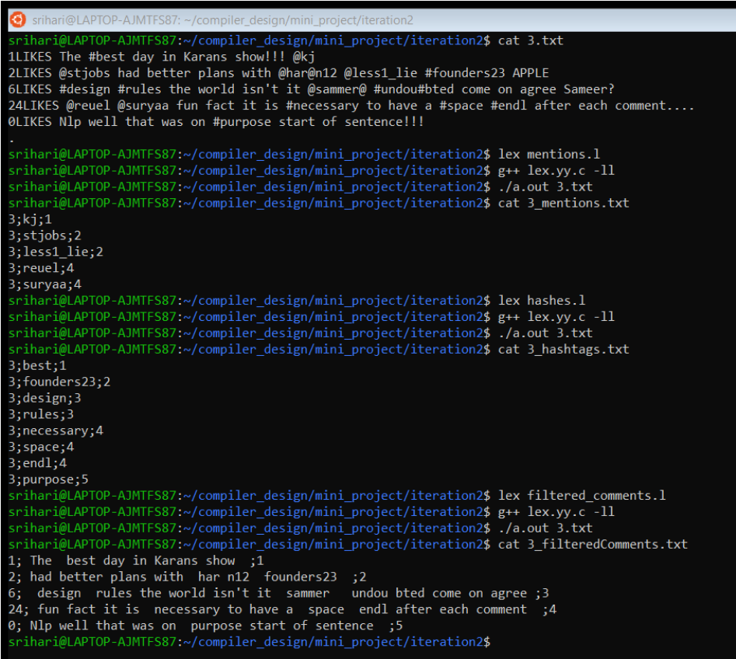
Module 1 Phase 1: Extraction of Mentions
Output File: 3_mentions.txt

Slide 10
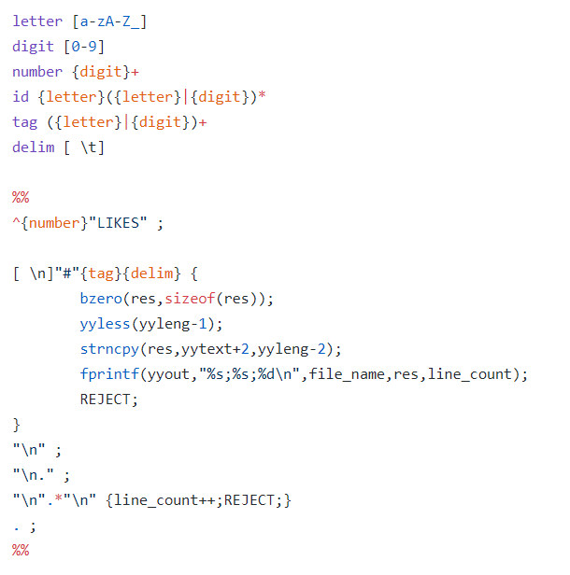
Module 1 Phase 2: Extraction of Hashtags
Any hashtag is of the form #word
Output:
A file x_hashes.txt is created which contains the list of accounts that have been mentioned in a comment of post “x”.
The details in x_hashes.txt are stored in the format:
PostID;word;CommentNumber
Definition of a hashtag

Slide 11
Module 1 Phase 2: Extraction of Hashtags
Output File: 3_hashes.txt

Slide 12
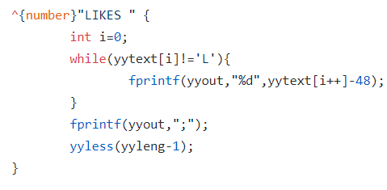
Module 1 Phase 3: Extraction of Filtered Comments
Output:
A file x_filtered_comments.txt is created which contains the comments of post “x” filtered by removing mentions, punctuations, proper nouns and stores the likes obtained by that comment.
The details in x_ filtered_comments.txt are stored in the format:
LikesObtained;filteredComment;CommentNumber
Storing the count of likes obtained by a comment
Notes:
A word is considered as a proper noun, if it begins with an UpperCase letter and doesn’t occur at the beginning of a sentence (or) if it is all UpperCase letters.

Slide 13
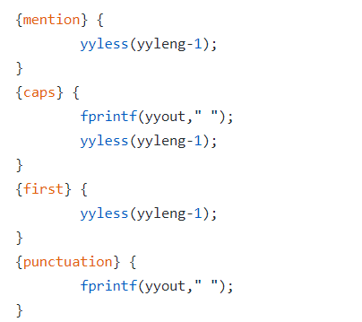
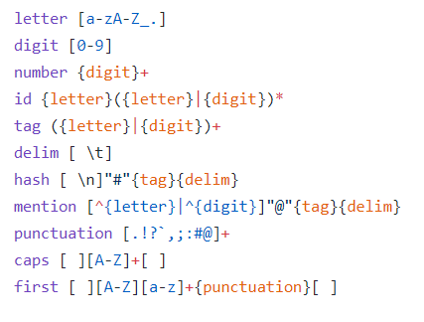
Module 1 Phase 3: Extraction of Filtered Comments
Elimination of proper nouns
Criteria for a proper Noun:
If((word[0] >= ‘ A’ && word[0]<=‘Z’ && doesn’t start a sentence) || (word.toUpperCase() == word))
return true;

Slide 14
Module 1 Phase 3: Extraction of Filtered Comments
Output File: 3_hashes.txt

Slide 15
Module 1: Intermediate Results
Input File: 3.txt (file containing the comments in user’s post along with the like count for each comment)
Output Files:
3_mentions.txt
3_hashtags.txt
3_filteredComments.txt
These output files are passed on to the Module - 2

Slide 16
Module 2: Database Storage
Input
Three files from output of Module 1
#_mentions.txt
#_hashtags.txt
#_filteredcomments.txt
Output
Stores the file contents in database in appropriate tables
Calls Module 3 along with #_filteredcomments.txt to run the analysis

Slide 17
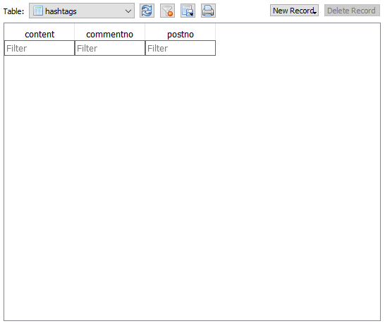
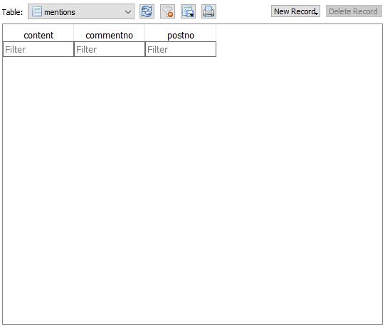
Module 2: Populating Database
Initially both hashtags and mentions tables are empty as shown above.

Slide 18
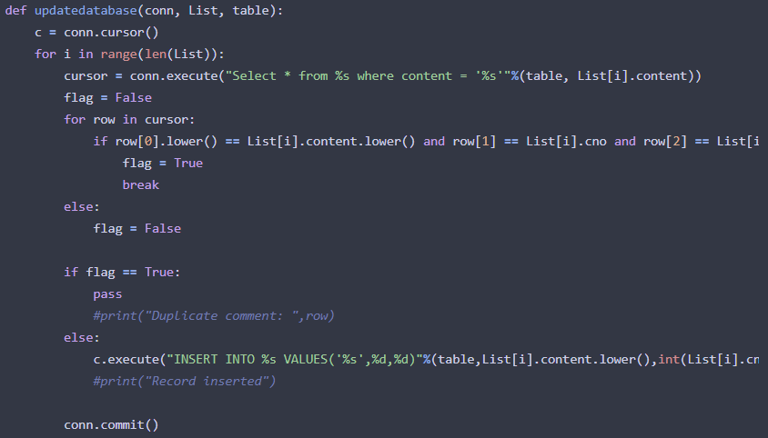
Module 2: Populating Database (Contd.)
Example File: 3_mentions.txt and 3_hashtags.txt
Code for updating and populating:

Slide 19
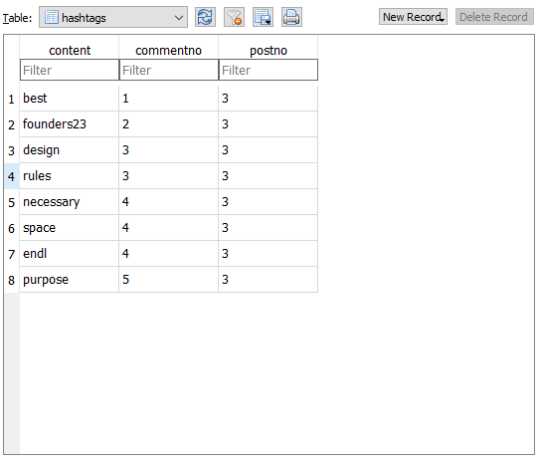
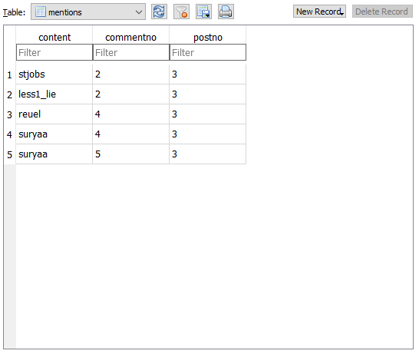
Module 2: Populating Database (Contd.)
Example File: 3_mentions.txt and 3_hashtags.txt
Database after population:

Slide 20
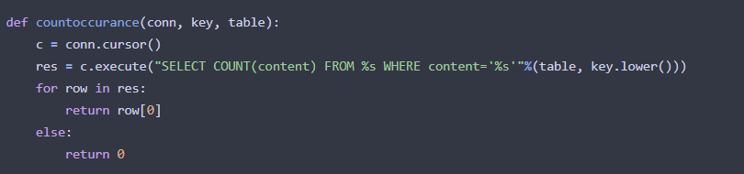
Module 2: Finding count
Code:
Note: Output shown and described in Module 4

Slide 21
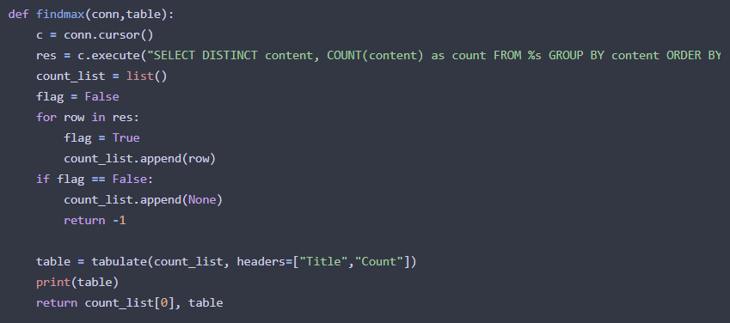
Module 2: Finding highest count
Code:
Note: Output shown and described in Module 4

Slide 22
Module 3: Overview
Input:
A text file containing the filtered comment with number of likes and serial number of comments
Phase-1 goal:
Emotional analysis of the filtered comments using lexicon to extract crux emotion of the post
Phase-2 goal:
Predicting the number of likes for a comment with features observed and extracted in previous phase

Slide 23
Module 3: What is afinn lexicon?
AFINN sentiment analysis in Python: Wordlist-based approach for sentiment analysis.
Developed and curated by Finn Nielsen, you can find more details on this lexicon in the paper, “A new ANEW: evaluation of a word list for sentiment analysis in microblogs”, proceedings of the ESWC 2011 Workshop.
The current version of the lexicon is AFINN-en-165. txt and it contains over 3,300+ words with a polarity score associated with each word.

Slide 24

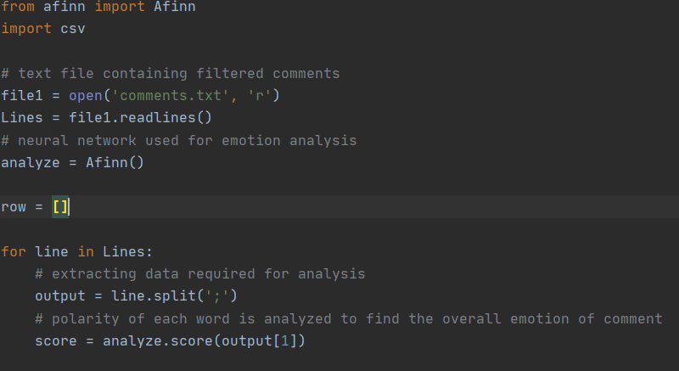
Module 3: Generating score for comments
comments.txt :

Slide 25
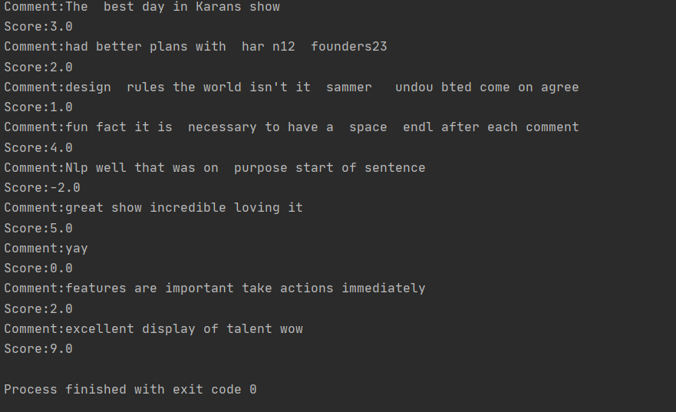
Module 3: Intermediate result for Phase 1
Result:

Slide 26
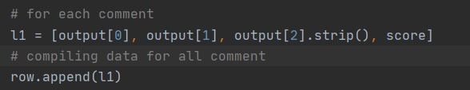
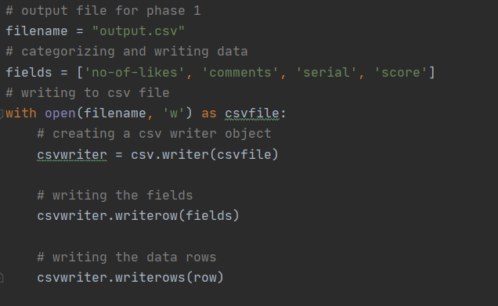
Module 3: Preparing data for Phase-2
We compiled the previously obtained data and included the score predicted using neural network.
We write the data onto an output file (‘output.txt’)

Slide 27
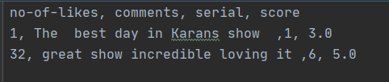
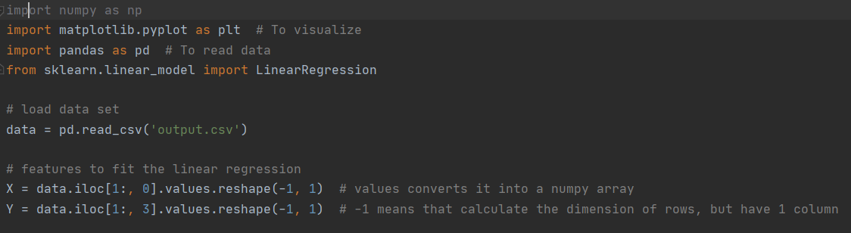
Module 3: Pre-processing data for Phase 2
Output.csv:

Slide 28
Module 3: Intro to Linear Regression
In statistics, linear regression is a linear approach to modeling the relationship between a scalar response (or dependent variable) and one or more explanatory variables (or independent variables).
Linear regression is a linear model, e.g. a model that assumes a linear relationship between the input variables (x) and the single output variable (y). More specifically, that y can be calculated from a linear combination of the input variables (x).
We choose X-axis to be the score for each comment predicted using the neural network and Y-axis to be the number of likes obtained in the comment .

Slide 29
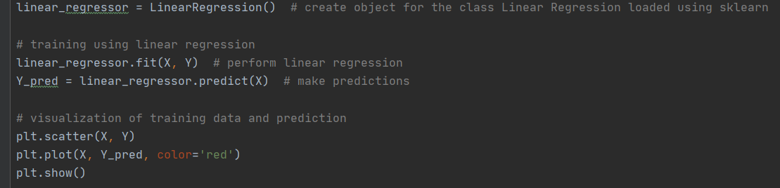
Module 3: Training and visualizing
We use LinearRegression() class available in sklearn library to train the data
We then predict using the training data
The plot of predicted and real data gives the insight into the comment trend

Slide 30
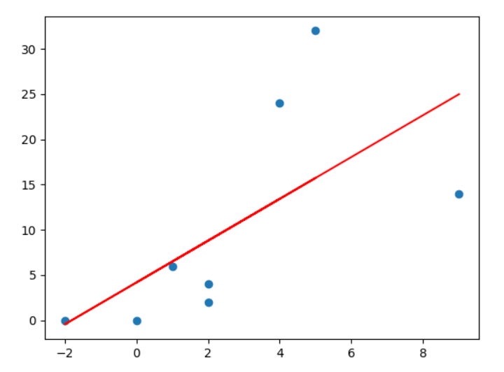
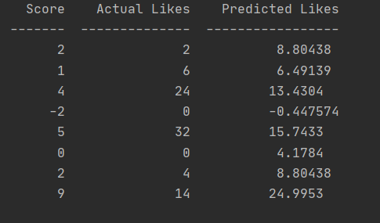
Module 3: Visualizing intermediate result
X-axis: Score Y-axis: No of likes

Slide 31
Module 4: Interface
This module focuses on combining all the modules and presenting it at a level of abstraction and ease of use to the user
Built on Python, it makes use of PyQt5 package for the interface
Each module is called by the interface depending on user’s wish.

Slide 32
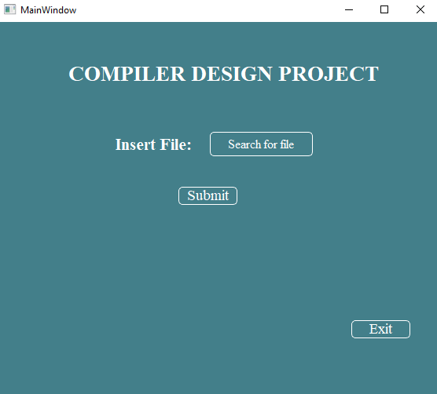
Module 4: Introductory Page
Uses Module 1
File entered by user is of the format specified in module 1
On submission, module 1 is called and its responsibilities are carried out.

Slide 33
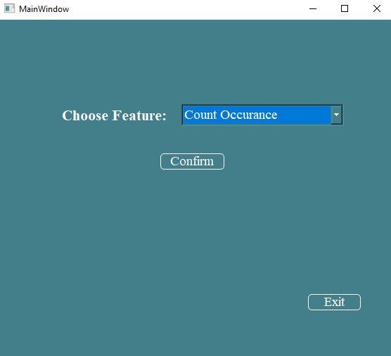
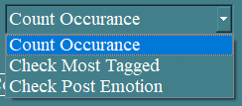
Module 4: Features Page
Uses Module 2
This allows user to make use of the features incorporated in our project
The feature options are:

Slide 34
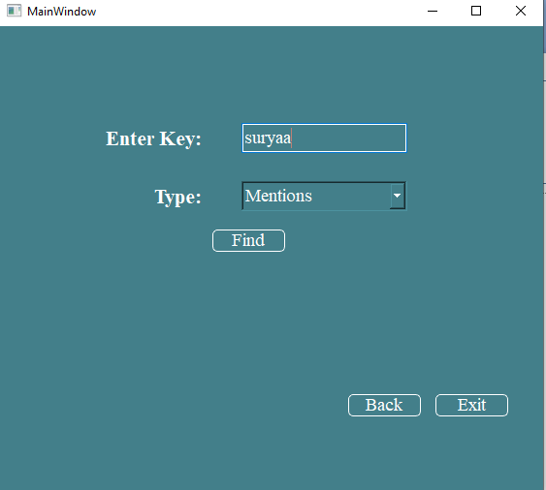
Module 4: Count Occurrence
Uses Module 2
Key string is then searched for within the database
Type specified informs the interface whether the user is looking for a mention or a hashtag.

Slide 35
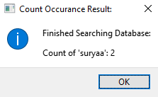
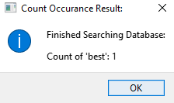
Module 4: Count Occurrence (Contd.)
Uses Module 2
Mention Search: key ‘suryaa’
Hashtag Search: key ‘best’

Slide 36
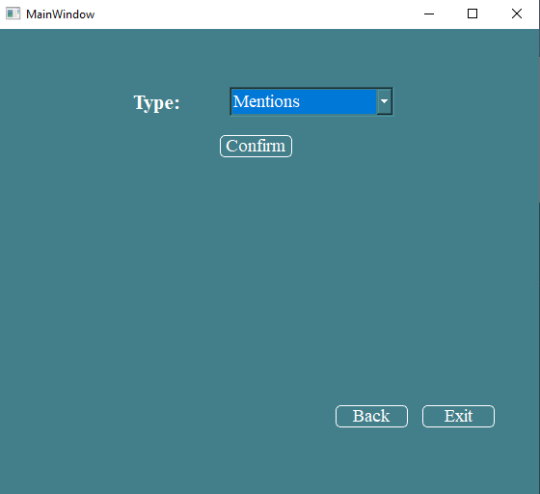
Module 4: Most tagged
Uses Module 2
User can check which mention or hashtag has been tagged the most on their post.
Makes use of functions specified in module 2

Slide 37
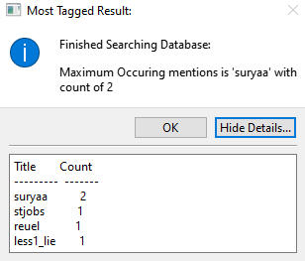
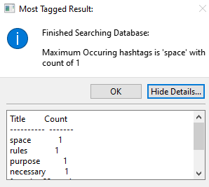
Module 4: Most tagged (Contd.)
Uses Module 2
Most tagged Mention
Most tagged Hashtag

Slide 38
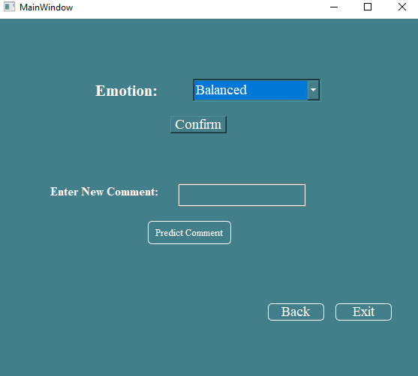
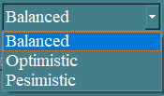
Module 4: Post Emotion
Uses Module 3
User can display the different comments based on emotion portrayed.
Emotions identified:

Slide 39
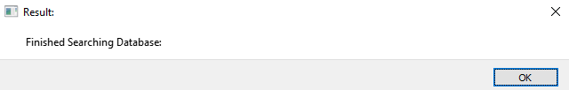
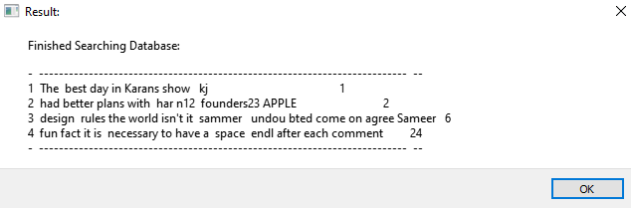
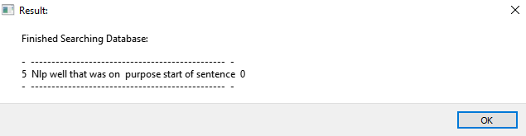
Module 4: Post Emotion (Contd.)
Uses Module 3
Emotion | Output
Balanced
Optimistic
Pesimistic

Slide 40
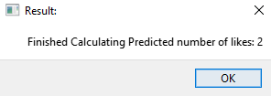

Module 4: Post Emotion (Contd.)
Uses Module 3
Here, a new comment is entered and the number of likes it will fetch is predicted

Slide 41
References
K. M. Anitha, V. Saraswathy, K. Gayathri and S. S. Priya, "An Approach To Comment Analysis In Online Social Media," 2019 3rd International Conference on Computing and Communications Technologies (ICCCT), Chennai, India, 2019, pp. 332-335, doi: 10.1109/ICCCT2.2019.8824949.
A. U. Hassan, J. Hussain, M. Hussain, M. Sadiq and S. Lee, "Sentiment analysis of social networking sites (SNS) data using machine learning approach for the measurement of depression," 2017 International Conference on Information and Communication Technology Convergence (ICTC), Jeju, 2017, pp. 138-140, doi: 10.1109/ICTC.2017.8190959.
Persia, F., & D’Auria, D. (2017). A Survey of Online Social Networks: Challenges and Opportunities. 2017 IEEE International Conference on Information Reuse and Integration (IRI).
arXiv:1103.2903 - A new ANEW: Evaluation of a word list for sentiment analysis in microblogs - Finn Årup Nielsen
A. U. Hassan, J. Hussain, M. Hussain, M. Sadiq and S. Lee, "Sentiment analysis of social networking sites (SNS) data using machine learning approach for the measurement of depression," 2017 International Conference on Information and Communication Technology Convergence (ICTC), Jeju, 2017, pp. 138-140, doi: 10.1109/ICTC.2017.8190959.
X. Lin, T. Bu, Q. He and Y. Liang, "A study on the impact of positive and negative comments on consumers' perceived usefulness," 2019 16th International Conference on Service Systems and Service Management (ICSSSM), Shenzhen, China, 2019, pp. 1-6, doi: 10.1109/ICSSSM.2019.8887617.
R. Singh, R. Bagla and H. Kaur, "Text analytics of web posts' comments using sentiment analysis," 2015 International Conference and Workshop on Computing and Communication (IEMCON), Vancouver, BC, 2015, pp. 1-5, doi: 10.1109/IEMCON.2015.7344534.

Slide 42
FUTURE SCOPE OF THE PROJECT
We are planning on analysing further to find dislikes to remove ambiguity of likes (Users who make a negative comment and like the post)
Taking a deeper approach to the project by finding adjective , adverb and other part of speeches and normalizing the polarity of the word accordingly. This is taken into consideration because some part of speeches tend to make a stronger impact on meaning than others.
Immediate plan on further developing the User Interface design
Longer vision ahead is to build a small scale social media platform and let users interact and extract further details to make an in-depth analysis.

